Slide 1
Disc Filter Cleaning in Drip Irrigation Based on IoT

Slide 2
Presentation Outline
Abstract
Objective
Methodology
Expected Outcome
Execution Plan

Slide 3
ABSTRACT
Disc filter cleaning : Disc filter is to clean the water upto 100 microns. Major disadvantages is the sedimentation of sand , dust ,very small particles etc. So we need to clean the disc filter for two days once by manually for that we can make it to clean by itself in affordable price.

Slide 4

OBJECTIVE
App
Server
Arduino
Relay
Solenoid
valves
Motor
Disc Filter
Output

Slide 5
PROPOSED SOLUTION / METHODOLOGY
Disc filter cleaning by using solenoidal valves and pressure difference in disc filter.
By passing the water in reverse direction filter will be cleaned dust comes from outlet pipe.
Direction of water will be changed using mobile application.

Slide 6
EXPECTED OUTCOME
While we pass the water in reverse flow process in the disc filter.
Dust particles in the disc filter will be cleaned and come out in outlet pipe.
Using mobile application the solenoids were controlled to execute the reverse flow process.

Slide 7
Execution Plan
We are using the solenoid valves to control the direction of flow.
Controlling the solenoid valves using arduino.
We are creating the app to give signals to arduino.
Creating a database for IOT.
Finally testing the outcome of the setup.

Slide 8
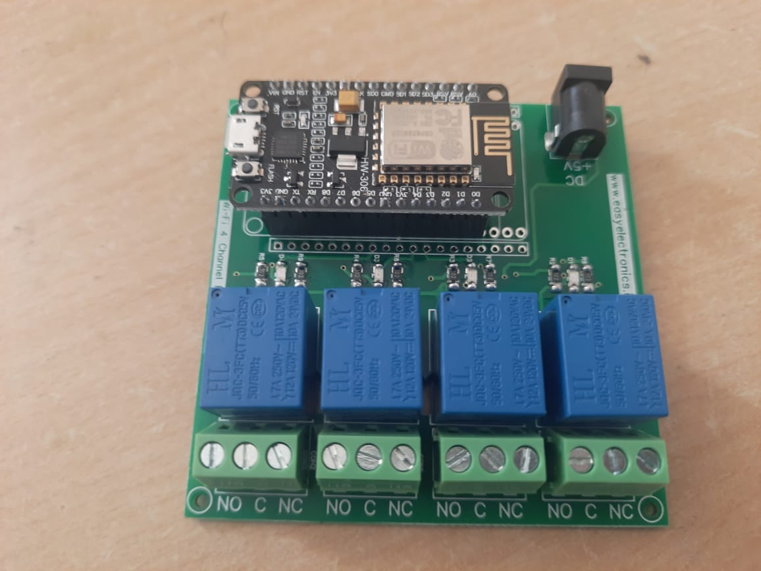
PCB BOARD

Slide 9
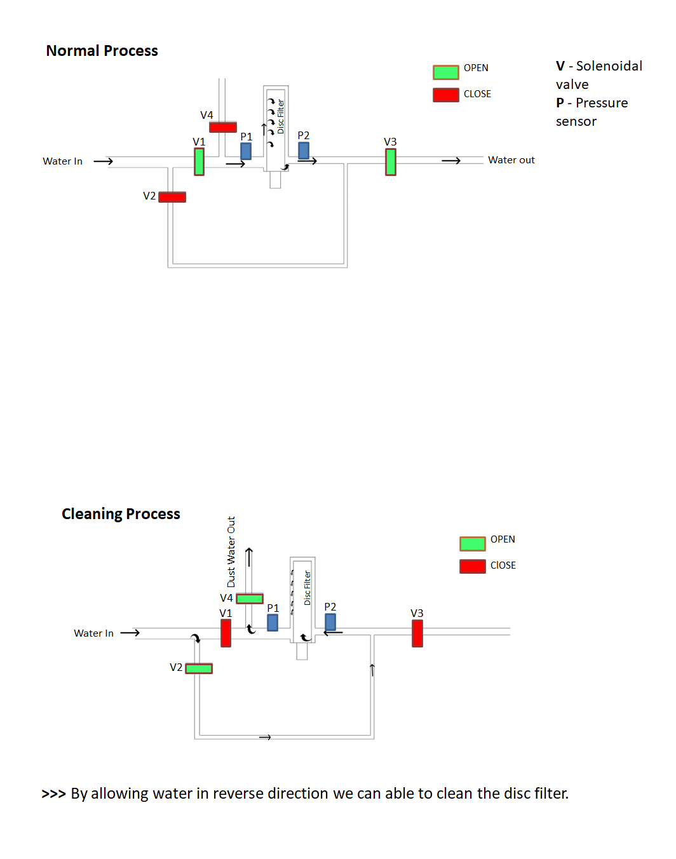

Slide 11
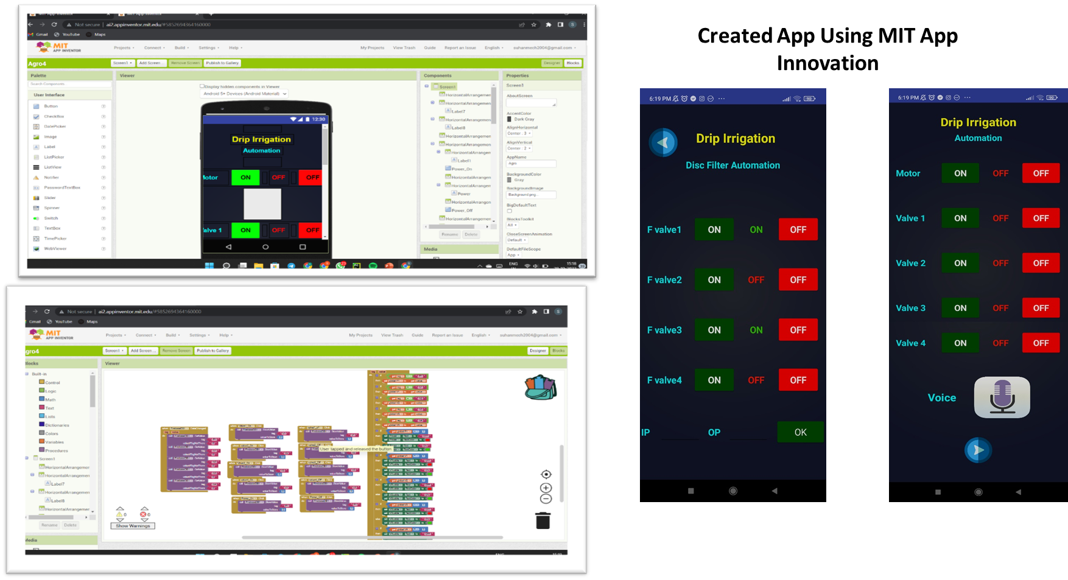
Mobile App Creation

Slide 12
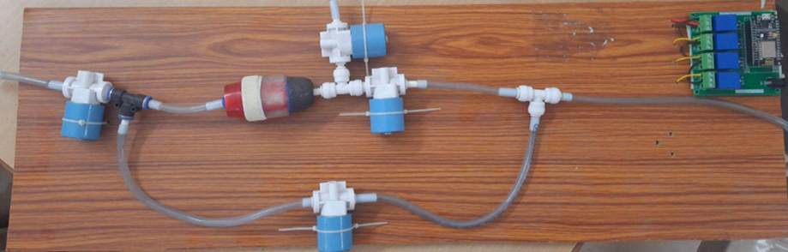
Prototype of Disc Filter Cleaning

Slide 13
Bill Of Materials
S.No | Equipments | Quantity | Cost
1 | Solenoid valve | 4 | 800/-
2 | Relay | 4 | 200/-
3 | NodeMCU | 1 | 450/-
4 | PCB Board | 1 | 500/-

Slide 14
Cost of disc filter cleaning system in field
S. No | Pipe Size (inch) | Disc filter | Solenoid valve (4 in Nos) | Tee joint (3 in No’s) | L-Bow (2 in Nos) | Total | Total system cost | Profit Margin%
1 | 1 | 3,000/- | 4,100/- | 50/- | 10/- | 19570 | 24160/- | 15 - 20
2 | 2 | 7,000/- | 4,900/- | 75/- | 45/- | 26915 | 31505/- | 15 - 20
3 | 2'1/2 | 9,000/- | 5,400/- | 90/- | 70/- | 31010 | 35600/- | 15 - 20
4 | 3 | 13,000/- | 6,000/- | 125/- | 90/- | 37555 | 42145/- | 15 - 20

Slide 15
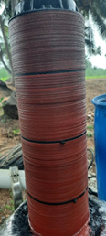
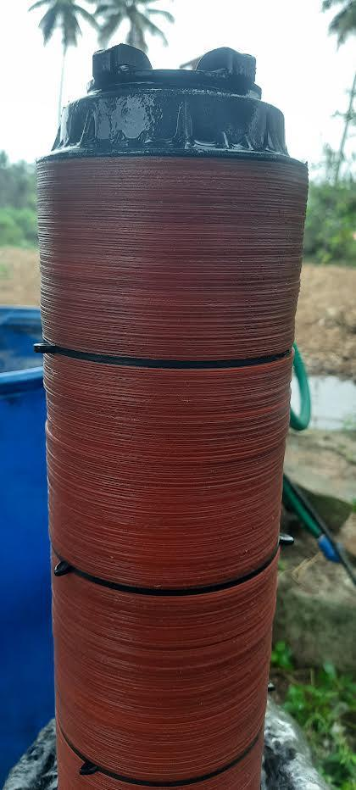
Validation of reverse flow process in field
Before
After

Slide 16
Conclusion
Thus two different types of flow were created through the filter namely forward and back flush flow using four solenoids.
Through MIT App inventor the flow has been reversed by making the valve 2 and valve 4 open.
Meanwhile by adopting MIT App inventor assisted with backflush flow between process forms an economic and time saving method for cleaning the drip irrigation disc filter.

Slide 17
THANKYOU

